Slide 1
Chapter 4
CONTRACT MANAGEMENT

Slide 2
Nepalese legal system
Components of a Legal System
1.The legal system of a nation includes:
2.acts/laws, court decisions/precedents (ain, kanun, nirnaya/najir)
3.rules, regulations, bylaws, directives (niyam, biniyam, nirdeshika)
4.treaties, conventions, policies, (sandhi, prachalan, niti)
5.formation orders, ordinance, promulgations, (adesh, adhyadesh, ghoshana,)

Slide 3
Nepalese Legal System
In Nepalese legal system, a person is practically “assumed guilty until proven innocent”. As soon as a person, or an officer, is charged of a crime, he/she is losses his/her official privileges, expected to resign from his/her post or automatically suspended till the case is “closed” by a court of law.
The Nepalese society normally presumes a person guilty as soon as s/he is charged of a crime.
People have very low level of faith on the impartiality of justice/legal system. Many persons found guilty by a court, but with good connection, roam in government offices, while persons with low access to resources waits for years, even decades, for court verdict on cases he/she files.

Slide 4
Structure of Nepalese Legal System
1.Supreme Court
2. High Courts(7)
3. District Courts(75)
4. Judicial institutions:
Debt Recovery Tribunal(ऋण असुली न्यायाधिकरण),
Revenue Tribunal(राजश्व न्यायाधिकरण),
Administrative Court(प्रशासकीय अदालत),
Foreign Employment Tribunal(वैदेशिक रोजगार न्यायाधिकरण)
Labor court (श्रम अदालत )and
Special court
5.Local level judicial committee

Slide 5
Contract Management
The law of contract is that branch of the law, which determines the circumstances in which a promise shall be legally binding on the person making it. (Sir William R. Anson)
A contract is an agreement enforceable at law made between two or more persons by which rights are acquired by one or more to act or forcible on the part of other or others’. (A.K. Sen)
Contract Management
The process of planning organization leading and controlling the work of organization members and of using all available organizational resources to reach stated organizational goals is understand as management.

Slide 6
Introduction: Contract Management
Contract management the process of ensuring that the supplier honours their negotiated contract terms.
Construction contracts management is the process of negotiating and managing all contract agreements involved in a construction project or company, such as those involving vendors or clients.
Contract managers must monitor cost, scope, quality, and time frame and must ensure that all contract conditions are met.
This important job affects both the financial and the actual success of the project or company.
When managing client contracts, a manager is mainly responsible for ensuring that all deliverables are provided to the client on time and ensuring that the client meets each payment date with the correct payment amount.

Slide 7
Introduction: Contract Management
Effective contract management involves daily activity tracking, performance management, and follow-up with the supplier.
Administration of a contract can include many specific duties, depending on the nature of the engagement.
The contract manager is responsible for communication between the parties, including status updates that track progress towards goals.
In many instances, he may act as the chief compliance officer for the contract, making site visits and doing spot checks to ensure nothing unusual is going on.
Most often, the contract manager is responsible for the expense budget, tracking expenditures, collecting receipts and liaising with the finance department to create financial reports.

Slide 8
Contract
According to contract Act of Nepal 2056 Nepal, a contract is an agreement between two or more than two parties to do or not to do any business.
This indicates that there involves at least two parties, one of which make an offer and the other is an acceptor.
Without an offer and acceptance, there cannot be a contract.

Slide 9
Essential elements of Contract
1.Offer and acceptance
Offer without acceptance or acceptance without offer does not make contract.
2. Competent parties
Parties or person who make contract must be competent according to law.
A person below 16 years of age, mad, senseless is incapable to make contract according to Contract Law of Nepal.
3. Legal relationship
Any contract must be made legal relationship between offerer and acceptor.
Providing a cup of tea by a friend and accepting it as an offer cannot make a contract for something.

Slide 10
Essential elements of Contract
4.Free consent
Acceptance or offer, both should be free consent from both parties.
A forced offer or forced acceptance cannot make a contract.
5.Lawful consideration
The contracting parties must have an offer and acceptance with a condition.
Any work done without any condition and the benefits obtained by other parties cannot be a contract.
6. Lawful purpose
Contract for doing cannot be an illegal matter or purpose

Slide 11
Essential elements of Contract
7.Possibility of performance
Any contract should be within possibility of performance.
8.Certainty
Contractual conditions must not be unclear and unlimited.
Both parties must have understood the term and conditions.
9.Lawful object
Illegal, immoral and against the public welfare
subjects/objects cannot be contractual matter.

Slide 12
Types of contract
As per legal consideration (based on the legal relationship and obligation of parties) contract may be valid, void, voidable and unenforceable;
Valid contract: an agreement enforceable by law is said valid contract
Void contracts: an agreement not enforceable by law is said to be void.
Voidable Contract: As per Contract act 2023, the following contracts are voidable, if any of the party desire to make it void-
Forceful contract
Entered in to contract because of undue influence
Contract involving fraud and or misstatement.

Slide 13
Significance of a contract
Makes agreement legally enforceable
Records the terms of agreement (terms of reference, scope of works)
Specifies the roles and responsibilities of each party of the contract
Specifies corrective measures in case of breach of contract
Specifies quantity & quality of work, work schedule and payment schedule & mode
Identifies parties of the agreement, and the official agents/representatives of the parties, if any.
Sets out in advance the course of action to be taken in different foreseeable situations
Defines words and establish common language
Defines limitations of the contract
Defines contract termination procedure
Defines responsibilities of the contracting parties to the third parties like government, community, workers, sub-contractor, material supplier, unions etc.

Slide 14
Factors to be considered in preparing a contract document
The contract must be fair to all the parties entering into the contract.
The language used in the contract must be clear (unambiguous).
The contract language must be consistent. Same word, phrase or abbreviation should not have different meaning in different location.
There should be no repetitions, as it tends to create confusion
Contract information must be retrievable by all the parties entering into contract, whenever they need it. So multiple original copies of the contract should be prepared.
The terms of the contract should not conflict with existing laws.
All legal provisions to make the contract valid and enforceable should be complied, like witness, immediate stakeholder (in case of land/property ownership transfer).

Slide 15
Interpretation of contractual clauses
If the language in the contract is clear, the words and terms are interpreted on the basis of the intention of the parties, which is reflected in the contract.
If the words and terms are not used to give special (or technical) meaning, the words and terms are explained or understood in their ordinary meaning.
If the words or terms are ambiguous or vague or used to give special (or technical) meaning, them outside help is taken in the interpretation of the words.
If the contract is ambiguous, with double meaning, or contains conflicting provisions, such words, terms or contractual clauses are interpreted in favor of the party who has not drafted the contract. This rule of interpretation is called contra proferentum (against the offerer) rule.

Slide 16
Contract Document
The papers that form complete document for
agreement of the works is contract document.
The contract document explains the size, type, and the quality of the works, its mode of construction, payments, design and drawing,
working drawing, legal bindings, obligations, etc.
for the smooth execution of the work.
Any misunderstanding in the work is explained
under the basis of the contract document.

Slide 17
Contract Document
A tender document is prepared under the following sections, which forms a contract document-
1. Invitation for bidders,
2. Bids distribution,
3. Instruction to bidders
i. General,
ii. Bidding document,
iii. Submission of bids,
iv. Bid openings and Evaluation,
v. Award of contract,
vi. Bidding data

Slide 18
Contract Document
4. Forms of bid, qualifications, information, letter of
acceptance and agreement,
5. Conditions of contract,
General,
Time control,
Quality control,
Cost control,
Finish the contract
6. Specifications,
7. Drawings,
8. Bill of quantities,

Slide 19
Contract Document
9. Security forms,
Bid security,
Performance bond,
Performance Bank Guarantee (conditional)
Performance Bank Guarantee (unconditional)
Bank Guarantee for Advance Payment

Slide 20
Public Procurement
Government procurement, also called public tendering or public procurement, is the procurement of works, goods and services on behalf of a public authority, such as a government agency.
A well functioning procurement system can be said to be in place if it achieves the objectives of transparency, competition, economy, efficiency, fairness and accountability

Slide 21
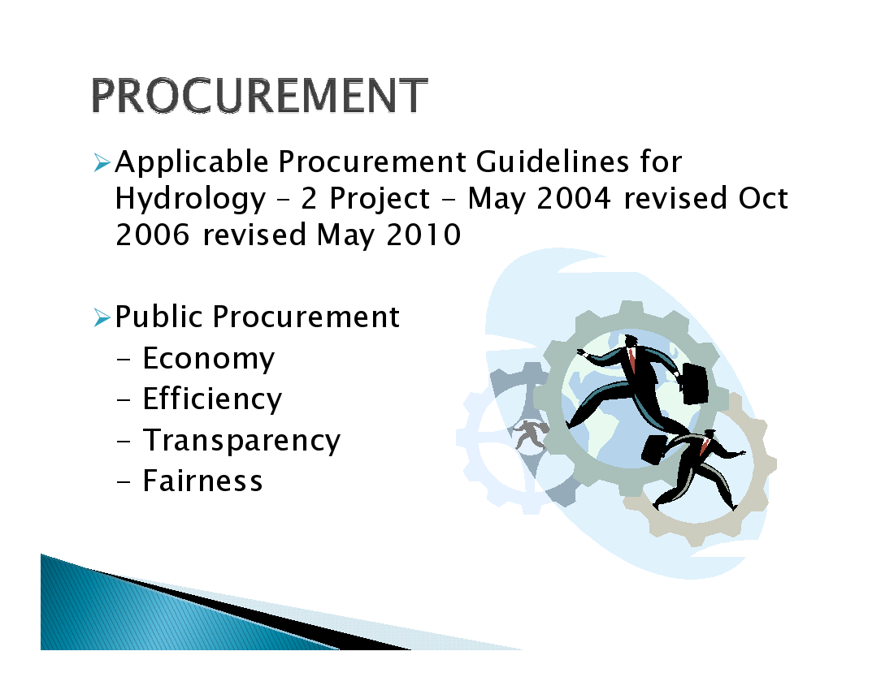
Principles of Public Procurement

Slide 22
Principles of Procurement
Transparency: Transparency is letting everyone know ,not only the facts and figures of procurement but also the mechanisms and procedures followed.
Equal Opportunity and Fairness: Being objective and ensuring impartial, unbiased and equitable treatment of tenderers by conforming with rules and standards free from discrimination and dishonesty.

Slide 23
Principles of Procurement
Economy: Achieving economy is getting the right thing at the right price -Value for Money (vfm)
Efficiency: With economy in price and choice of item, ensuring its arrival in the right place at the right time for its intended use is Efficiency -Money for Value(mfv)

Slide 24
Provisions Relating to Responsibility for Procurement and Procurement Methods
Description of Goods, Construction Works and Services to be Prepared
Cost Estimate to be Prepared
Procurement Plan to be Prepared
Responsibility Towards Procurement Activities
Preparing standing lists
Procurement Method to be Selected

Slide 25
Classification of Procurement
Procurement of Goods and Materials
Procurement of Services
Procurement for Works

Slide 26
PROCUREMENT PLANNING
Separate planning for procurement of:
1.Goods
2. Consulting services
3. Works

Slide 27
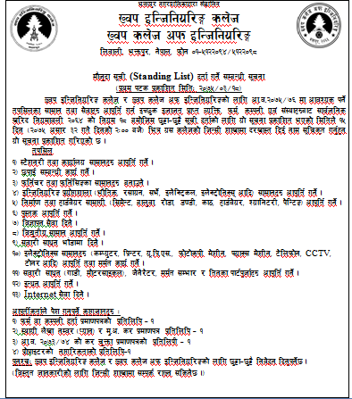

Slide 28
Method of Work Execution
No. | Procurement Method | Contract Size | Contractor
1 | Sealed Bidding
i. | ICB | Not mentioned | International, International Nepali JV, Nepali JV
ii. | NCB/LCB | More than 2 million | All
2. | Sealed quotation | up to 2 million | All
3. | Direct Procurement | up to 5,00,000 | All
4. | Force Account | up to 1,00,000 | None
5. | Procurement under special circumstances | Emergency / Special Circumstances | Depends on contract amount
6. | Users' Committee | up to 6 million | Contractor cannot be used.

Slide 29
Method of Work Execution
Sealed Competitive Bidding
National Competitive Bidding (NCB)
Local competitive bidding
Tender notice is published in national newspaper with a period of at least 30 days shall be given.
International Competitive Bidding (ICB)
Tender notice shall be published in national newspaper in English language providing a period of at least 45 days.

Slide 30
Method of Work Execution
Sealed Quotation:
Before inviting a sealed quotation, a form of sealed quotation stating clearly therein the specifications, quality, quantity terms and conditions of supply and time and other necessary matters of goods, construction work.
Notice shall be published in a national or local level news paper by giving a period at least of 15 days.
Sealed quotation once submitted cannot be withdrawn or amended.
Lowest evaluated sealed quotation falling within the cost estimate after fulfilling the terms and conditions shall have to be approved.

Slide 31
Method of Work Execution
3. Direct Procurement:
Section cannot be directly procured from the same individual firm more than 1 time in a fiscal year.
If only one company has the technical efficiency to fulfillment the procurement requirement.
If unique qualification is immediately needed for the concerned work.

Slide 32
Method of Work Execution
4. Users Committee:
The main objective of the project is to create employment and to have the beneficiary community involved.
Force account(on Amanat):
Construction work to be carried out by a Public Entity Itself.
Size, nature and location of the work being unsuitable for competitive bidding.
No contractor is interested in carrying out the works.
Emergencies.

Slide 33
Method of Work Execution
6. Special circumstances:
Emergency/ Special circumstances
depends on contract amount.
7.Catlogue shopping
8. Limited tendering
9. Buy back method
10 . Lump- sum method

Slide 34
TENDERING PROCESS
A tender is a submission made by a prospective supplier in response to an invitation to tender. It makes an offer for the supply of goods or services.
In construction, the main tender process is generally for the selection of the contractor that will construct the works.

Slide 35
DETAIL INFORMATION IN TENDER NOTICE
Name of the Authority publishing the notice.
First date of publication
Brief description of the job.
Date, time and place where the tender document is available and to be submitted.
Cost of tender document.
Cost estimate (optional)
Earnest money and security deposit amount.
Date, time and place where the tender will open.

Slide 36
EARNEST MONEY OR BID SECURITY
It is the amount of money deposited while bidding as a guarantee of the party's willingness of carrying out the work if awarded to him.
2-3% of the Project cost is demanded as earnest money.
This fund is refunded to unsuccessful bidder.
If a successful bidder fails to carry on (sign) the contract, this amount is forfeited.

Slide 37
PERFOMANCE GUARANTEE
It is the amount deposited by successful bidder as a security for satisfactory performance.
In Nepal, it is 5% of bid amount for Nepalese firm & 10% for foreign party.
It is refunded after defect liability period.
If contractor fails to carry on his duty, this amount is forfeited.

Slide 38
TENDER DOCUMENTS CONTAINS
Tender Notice
Form of Contract agreement
Conditions of Contract
Drawing
Specifications
BoQ(bill of Quantities)

Slide 39
BIDDING PROCESS
The Competitive Bidding process includes six main phases:
Advertisement,
Preparation and Issuing of the Bidding Document,
Bid Preparation and Submission,
Bid Opening,
Bid Evaluation, and
Contract Award

Slide 40
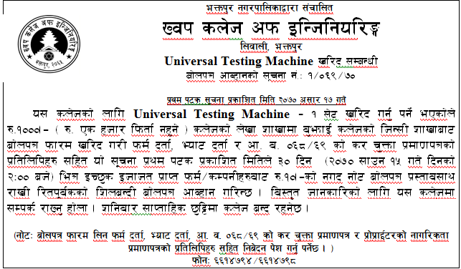
Inviting open bids at national level

Slide 41
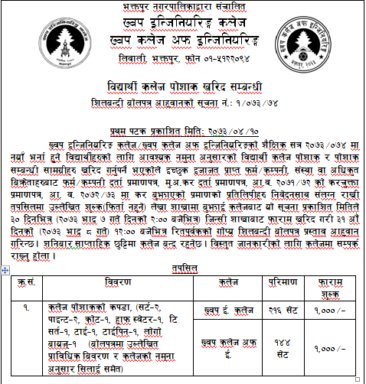
Inviting sealed quotations

Slide 42
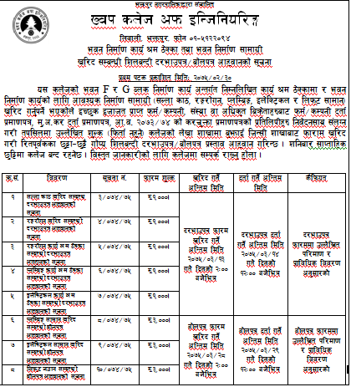

Slide 43
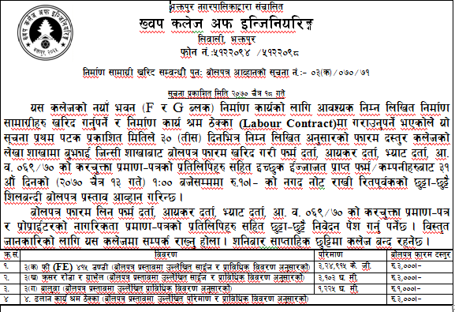

Slide 44
PREPARATION BEFORE TENDER
Complete and receive the project design.
Get final project estimate.
Get the estimate approved by the approving authority
Prepare tender documents and approved by approving authority.
Prepare tender documents to be sold.
Equip the project office to handle all the quarries of prospective bidders.
Ensure availability of fund for the project.
Employ supervisory manpower.

Slide 45
CONDITIONS OF CONTRACT
Contract being the legal agreement all the terms are clearly spelled out for easy functioning and minimize the dispute.
Condition of Contract documents are
i) General Condition of Contract.
ii) Special conditions of contract.

Slide 46
CONDITION OF CONTRACT
General
Definition of terms
Project manager decision
Language and law
Employer risk
Contractor risk
Type of contract
Access to the site
Procedure for dispute settlement and so on.

Slide 47
B. Time Control
Management meeting
Early Warning
Extension of intended completion date
Penalty
C. Quality Control
Test
Correction of defect

Slide 48
D. Cost Control
Mode of Payment
Payment for variation
Currencies
Security deposit
Advance payment
E. Finishing the contract
Termination
Payment on termination
Release from performance

Slide 49
CONTRACTOR’S PREQUALIFICATION
Prequalification
Post qualification
Prequalification
It is a kind of short listing of eligible contractor & avoids crowding of bidders taking account of their;
Experience of contractor
Financial capability
Equipment Capability
Litigation history ( legal dispute)

Slide 50
Objective of Pre-Q
List the experienced and interested contractor.
Avoid rejection of bids.
Time as:
30 days for NCB
60 days for ICB

Slide 51
2. POST QUALIFICATION
No Pre- qualification is done.
All participants are given chance for bidding
May be selected by
a) single envelop system or
b) double envelop system
According to their Financial & Technical Proposals.

Slide 52
TENDER EVALUATION
Opening of Bid:
A Public Entity shall have to open a bid in the presence of the bidder or its representative.
Preliminary Examination of Bid:
The purpose is to identify and reject the bids.
verification of signature
registration
J/V agreement
Eligibility
Bid security
Completeness
Qualification

Slide 53
TENDER EVALUATION
The purpose is the determine the lowest evaluated bid in accordance with the terms and conditions of the bidding documents.
If any arithmetical error is found in a bid, the Public Entity may correct such an error.
Where there is a discrepancy between figures and words in a bid submitted by a bidder, the amount in words shall prevail.
The qualification of the bidder of the bid having the lowest bid price is in conformity with the qualification evaluation criteria set forth in the bidding documents, such bid shall be the lowest evaluated substantively responsible bid.
Within 7 days of the selection of the bid, the Public Entity shall serve a notice of the intent of acceptance of bid to the concerned bidder.

Slide 54
TENDER EVALUATION
COMMERCIAL REASONS FOR REJECTING BIDS:
Bid security or bid validity period not in accordance with bidding document.
Inability to meet critical schedule.
Failure to comply with minimum experience or financial capability.
Conditional bids.
TECHNICAL REASONS FOR REJECTING BIDS ARE
Failure to bid for the required scope of work.
Failure to quote for each item in BOQ.
Failure to satisfy major requirement in the specifications.

Slide 55
TENDER EVALUATION
BID EVALUATION REPORT:
The bid evaluation committee shall prepare a Bid evaluation report within 15 days of staring of bid evaluation.
If there is no donor involvement or the donor does not require no objection, the Project manager of competent authority may enter into negotiation or agreement process.

Slide 56
AWARD OF CONTRACT
Within 7 days of the approval of the recommendations the Bid Evaluation Committee, the employer may issue the letter of intent to accept the lowest evaluated responsive bidder.
the information is to given to all bidders through public notice in newspaper.
If no any persons submitted any complain about the selection, the contract is awarded to the selected bidder and called for agreement with required performance bond within 15 days.

Slide 57
